Slide 1

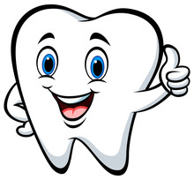
What: Free Mobile Dental Clinic
When: Tuesday Sept. 9th from 9:00-3:00
Where: Campus Cafeteria (old school Cafeteria)
Fillings! Cleanings! Check-ups! Exams!
Come see us and show us your beautiful smile!
This is a free clinic offered by Medical Teams International in collaboration with Warm Springs Managed Care

